Slide 1
Colorado’s Budget:
The Best of Times
The Worst of Times
Tim Hoover
Communications Director
Notes:
One of the best econs in country, but we’re go to make 500m cuts to schools, roads and hospitals. Isn’t this crazy? How can this be?

Slide 2
Building the FY2017-18 Budget
November 2016: Governor’s Budget Recommendations says there is a $500 million gap
December 2016: Quarterly state revenue forecast is released and now that gap is $600 million because of the Gallagher Amendment which impacts local property taxes
February 2017: Governor recommends increasing marijuana taxes and cutting Senior Homestead Exemption
March 2017: Budget Cuts still not worked out
Notes:
Let’s flashback to November. Giov’s bjt says we’re 500m short. Money next year won’t even cover current obligations on books. Month later, rev esti come out and now the gap has grown to 600m to automatically goof up prop taxes. I’m going to explain why we have a shortfall in a great economy, and what this Gallagher Amendment is all about and how it’s making things worse.

Slide 3
Three basic pots of money in the State budget
$27.1 billion total budget in FY2016-17
$7.5 billion
Total budget includes $1.5 billion “reappropriated funds”
Notes:
Here’s our state bjt.

Slide 4
General Fund Revenue Sources
Sales, use, and excise taxes
Individual Income Taxes
Other Sources
Corporate Income Taxes
FY2016-17 $10.5 billion

Slide 5
What does the money buy?
Courts
Other
Transportation
Public Health
Human
Services
Schools
Colleges
Public Safety
49th in size of state government
45th in state taxes
Healthcare
FY2016-17
Colorado General Fund $10 billion
Notes:
We give a big slice of pie to schools, but pie is small. Only Texas, where everything is bigger, has a smaller pie. Our elected officials have very tough decisions to make.

Slide 6
Money for budget goes up and down with economy
Caseloads increase whether or not money is available
Notes:
This slide shows you how state tax collections, made up of income and sales taxes, fluctuate with the economy. Back in 2009 during the Recession, our tax collections plummeted and we had a real crisis. Kids were still turning 5 years old, yet their parents may have been unemployed and now on Medicaid or they went back to college, particularly community college. We can’t borrow money during a downturn, we have to make cuts. We cut schools and higer ed. Now we’re in the bizarre situation of having the best economy in the nation – and cutting schools, roads, colleges and hospitals.

Slide 7
Explanation: TABOR (Article X Section 20) Major Provisions
Constrains the legislature’s Choices
Caps Revenue
Limits Options
Sets Election Provisions
Notes:
TABOR was 1,900 words. Nobody read it. A lot of people haven’t even ever heard of it. They think it’s a shopping mall. If they know one thing about it, it’s that that it requires them to vote on taxes.
It also says we can’t have certain kinds of taxes, graduated income tax, statewide millage.
Itr also sets election provisions on how we vote on taxes and how the ballot language must appear. Four horsemen: “SHALL TAXES BE RAISED”
TABOR limits how big government spending can grow. If it grows faster than the cap allows, we have to issue tax rebates.

Slide 8
TABOR rebates return in FY2017-18
FY 2018-19
$289 million above cap
FY 2017-18
$264 million above cap
FY 2016-17
$161.8 million below cap
FY 2015-16
$122 million below cap
March 2017 Legislative Council Forecast
Notes:
The cap is based on inflation plus population. The Red line represents the cap. You can see that in the coming budget year, we’re $264 million above the TABOR limit.

Slide 9
TABOR Rebates are Paid from General Fund
Income and Sales Tax
General Fund
Cash Funds
TABOR Rebates
Fees

Slide 10
Enterprising the HPF Without Lowering Cap
Hospital Provider Fee removed allows $600 million room below revenue cap and allows full funding for hospitals and an extra $264 million for the General Fund

Slide 11
Enterprising HPF under SB-267
Hospital Provider Fee removed and revenue cap is lowered; there still is a General Fund obligation for $100 million in TABOR rebates in FY17-18 and $162 million in FY18-19

Slide 12
FY2017-18 General Fund Shortfall
Refill Reserve to 6.5% $169 m
Medicaid caseload $143 m
K-12 inflation and new students $203 m
Changes in Local Share for K-12 $178 m
Transfers to roads/construction $166 m
TABOR rebates $264 m
$1,123 m
New Revenue $613 m
Shortfall $ 510 m
Source: Governor’s FY2017-18 Budget Request OSPB and Legislative Council December Forecast 2016
Notes:
The enrollment count for the current (2016-17) school year totaled 832,519 FTE students across Colorado’s public schools, up 5,291 FTE students, or 0.6 percent, from the previous school year.
• Statewide K-12 enrollment is projected to increase by 7,415 FTE students, or 0.9 percent, in the 2017-18 school year. Enrollment in the 2018-19 school year is expected to increase 0.7 percent, or by 5,864 FTE students.
• All nine forecast regions will experience growth in enrollment over the next two school years. Growth will be strongest in the southwest mountain and northern regions, where strong job growth, and new and relatively more affordable housing options will continue to attract young families.

Slide 13
Medicaid
Traditional Medicaid
Expansion Medicaid
Notes:
Remember the big slice of pie devoted to Medicaid? There’s a narrative at the capitol that Medicaid is why we can’t have nice things. So why don’t we just cut it? And there’s a lot of confusion around traditional Mediciad vs. the expansions under Obamacare.
Let’s be clear. Traditional Meidicaid is old people, disabled, poor children, pregnant woman. The expansion covered low-income adults, mostly low-wage workers. So can we just cut those people who are working but can’t afford health care?
Kids comprise 44% of Medicaid enrollees, but account for only 19.2% of costs

Slide 14
Rolling Back Medicaid Expansions Won’t Fix Shortfall
95% Federal Dollars
5% Hospital Provider Fee
Traditional Medicaid
Expansion Medicaid
Notes:
The problem is that the expansion population in blue is not paid for out of the general fund. Cutting those people doesn’t free up money that can help schools or anything else.
Kids comprise 44% of Medicaid enrollees, but account for only 19.2% of costs

Slide 15
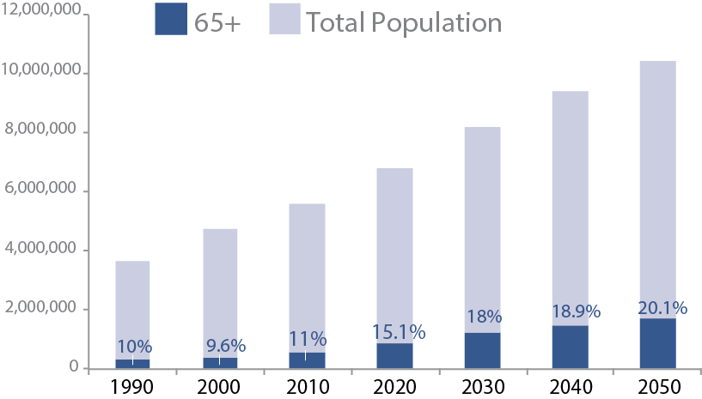
Medicaid Cost Drivers
Aging population
Growth in low-wage jobs
Decreasing wait time
Rising health care costs outpace inflation. From 2006-2015 medical care prices rose 39.7 percent in Colorado while inflation only grew by 21.4 percent.
Source: Medicaid Trends and Cost Drivers, Legislative Council Memorandum 2016

Slide 16
Not Much Room to Cut Traditional Medicaid
General Fund Cost FY2014-15
Restrict Benefits
Prescribed drugs $110 million
Home-based services* $385 million
Home therapy** $25 million
Restrict Eligibility
Elderly and disabled up to 300% FPL $408 million
Pregnant adults above 133% FPL to 195% $10 million
*Cutting would just result in higher nursing care facility costs
**e.g. Occupational therapy at home isn’t required by federal requirements but is required through outpatient hospital care
Source: JBC’s HCPF Briefing Document page 72-78 found at
http://www.tornado.state.co.us/gov_dir/leg_dir/jbc/2015-16/hcpbrf1.pdf
Notes:
There are things we do above the minimum, but ti won’t save us money. For example, providing drug coverage saves us money because not covering drugs would cost us more because of the ER. If we cut home health services … If we cut occupational therapy in home health care we’re still required to cover at nursing homes, where it’s more expensive.
Could we lower eligibility? We could. But the bulk of the people are old and/or disabled. Anyone feel like telling an elderly person in a wheelchair to just go suck it up?

Slide 17
Drop in Local Effort is Widening Shortfall
Notes:
Now let’s talk about how the drop in local property taxes is affecting the state budget.

Slide 18
How do Local Property Taxes Impact State Budget? Both state and local dollars pay for schools
FY2016-17
Doesn’t include local override mills and other local sources outside school funding formula
Notes:
The state provides about two thirds of the cost of schools while one-third is made up of property taxes, collected locally. If the local effort falls, the state has to backfill more of it out of the general fund.

Slide 19
The Context of Gallagher
Solving a “Fairness” problem
The residential property tax relief component was almost an after thought (45-55 split)
Most of Gallagher is non controversial
Periodic reappraisal
Market value assessment
Notes:
So, let’s all hop in the Delorean and go back to the future of 1982. Most of Gallagher focused on reappraisal procedures to make them uniform statewide to eliminate a lot of inconsistencies.
However, there was another part – 45-55 split. 45 percent had to come from homes while the remaining 55 percent had to come from non-residential.

Slide 20
How are Property Taxes Calculated?
Property Tax = Property Value X Assessment Rate X Mill Levy
determined locally
by market value
set by the state
by property category
—e.g. residential, commercial
established at
local district level
X 7.96%
X 95 mills = $2,647
= $27,860
$350,000

Slide 21
Back to 1980s….
Local Share
State
Share
Residential Assessment Rate
21%

Slide 22
X 29%
x 21%
x 7.96%
Residential Assessed Value
~45%
Non-Residential Assessed Value
~55%

Slide 23
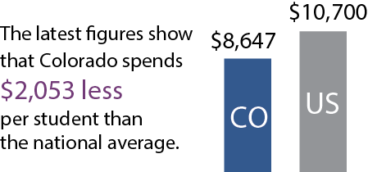
Today
Early 1980’s
Local Share
Local Share
State
Share
State
Share
Residential Assessment Rate:
21% 7.96% (drops to 6.56% this year)
Notes:
This is why the state has to backfill a lot more than it used to. Just a note, the drop is going to be even bigger, taking us under 7 percent, costing the state about $179 million more that it will have to backfill.
Note: Your home might have increased in value and you may be paying more in taxes, but remember, in a lot of places around the state, property values have been stagnant or have even increased. That means actual, net reductions in property tax collections, not merely a decrease of an increase.

Slide 24
Drop in Local Effort Means more Comes from GF

Slide 25
Businesses Don’t like Gallagher
Property Tax = Property Value X Assessment Rate X Mill Levy
determined locally
by market value
set by the state
by property category
—e.g. residential, commercial
established at
local district level
X 29%
X 95 mills = $9,643
= $101,500
$350,000

Slide 26
Market Value Today is 75% Residential
which well exceeds the target of 45%
Residential 75%
Residential 45%
Nonresidential 25%
Nonresidential 55%
Market Value
Target Share

Slide 27
Increase tax the special state sales tax on marijuana
The special state sales tax rate is supposed to be 8% this year. Voters approved that the rate could go as high as 15%.
Raising it to 12% would generate an additional $42 million
Notes:
Options for things the state is considering. We already approved lawmakers jacking it up to 15 percent.

Slide 28
Reduce: Senior Homestead Exemption
Constitutionally created tax credit for seniors who are 65 or older, and who have lived in their home for at least 10 years.
Exemption is 50% of the first $200,000 of actual value
The Legislature has the power to change the size of the credit
In 2010 and 2011, the General Assembly effectively eliminated the credit, by reducing to zero the value exemption from taxation
Cost in 2017: $144.6 million (Leg. Council)
Cost in 2002: $61.5 million (Leg. Council)
Notes:
Gov. has called for cutting homestead in half.

Slide 29
Homestead Exemption Example
X 7.96%
X 95 mills = $2647
= $27,860
$350,000
-$100,000
X 7.96%
X 95 mills = $1891
$250,000
= $19,900
State pays $756
95 mills is average in Jefferson County
Notes:
Local governments don’t lose the money. State backfills it. Cutting this in half would be a $350 break.

Slide 30
Questions?
Colorado Fiscal Institute
720-379-3019
www.coloradofiscal.org
Hoover@Coloradofiscal.org
Get Involved:
Let us be a resource
Join Our Email list

