Slide 1
You Can’t Manage What You Don’t Measure
Championing Equity to Inspire Change Conference
University of Denver
May 10, 2013
Kathy White
Deputy Director
White@Coloradofiscal.org
Chris Stiffler
Economist
Stiffler@Coloradofiscal.org

Slide 2
EQUITY
CULTURE
JUSTICE
INDEPENDENCE
WEALTH
POWER
SECURITY
HAPPINESS
FAMILY
CREATIVE EXPRESSION
PARTICIPATION
PEACE
FREEDOM
CARE
ENVIRONMENT
GROWTH
HEALTH

Slide 3
The Way We Measure Well-Being Dictates Policy Discussion
“You can’t improve what you don’t measure.”

Slide 4
Colorado Fiscal Institute is a nonprofit, nonpartisan organization that provides credible, independent and accessible analyses of fiscal and economic issues facing Colorado in order to inform policy debates and foster economic prosperity for all: http://www.coloradofiscal.org 1905 Sherman Street, Suite 225 Denver, Colorado 80205 720-379-3019

Slide 5
GDP Powers Through…
Catastrophic Toll:
1,836 preventable deaths
850,000 housing units damaged
600,000 job disruptions
Contamination of drinking water
National Economic Forecast headlines October 2005:
The U.S. economy shook off headwinds from hurricanes Katrina and Rita to grow at a faster-than-expected 3.8% annual rate in the 3rd quarter….

Slide 6
What is Gross Domestic Product?
A gross tally of everything produced in the U.S.—products and services, good and bad.
Never intended to be a measure of well-being, yet remains a “catch all” for our collective well-being.
This calculation gives the monetary value of all the goods and services purchased within national borders by persons, businesses, governments and foreigners. As a raw data analysis, GDP gives a broad overview of the market economic activity that takes place.
Notes:
Makes no distinction between $100 spent on a dinner at a restaurant, $100 on asthma medication, or $100 to replace a stolen laptop.

Slide 7
What is missed by broadly adding up all transactions?
No distinction between good and bad consumption
No mention of distribution of growth
No idea how that spending is funded
Doesn’t account for capital accumulation or depletion
Excludes all non-market aspects of economy

Slide 8
What does GDP Miss?
Pollution
Crime
Inequality
Lost Leisure Time
Education
Commute Time
Cost of Family Changes
Health
Social Cohesion
Community Extracurricular Activities
Public Infrastructure
Notes:
To define, the GDP is the market value of all final goods and services. And while this is an important measure, it is a very incomplete one. First, GDP does not measure what is being measured. It does not distinguish between buying a nice dinner, having to replace a stolen laptop, or paying for your asthma medication.
Second, GDP doesn’t care who does the buying. Equality is not included. So GDP ignores whether the very few buy everything or there is more equitable distribution of income and purchasing. Third, GDP misses critical non-market activities like pollution, resource depletion, volunteerism, and family contributions.

Slide 9
Simon Kuznets: "Distinctions must be kept in mind between quantity and quality of growth, between its costs and return, and between the short and the long term. Goals for more growth should specify more growth of what and for what."
Simon Kuznets, the creator of GDP, in 1962
Joseph Stiglitz: "No one would look just at a firm's revenues to assess how well it was doing. Far more relevant is the balance sheet, which shows assets and liability. That is also true for a country."
Nobel Prize-winning economist Joseph Stiglitz on GDP and learning from business, Foreign Affairs, 2005.
Robert McNamara: Progress measured by a single measuring rod, the GNP, has contributed significantly to exacerbate the inequalities of income distribution."
President of the World Bank Mr Robert McNamara on GDP and social equity in 1973.

Slide 10
HUBBARD It’s mainly optimism about the country’s prospects. The three big measures of economic power are the size of your economy, your [gross domestic product]; the growth of GDP; and where the productivity frontier is. If you put those together, the U.S. seems like a pretty great place to be.
Brownstein, Ronald (April 2013) “Two Completely Different Ways to Deal With the Upward-Mobility Crisis” National Journal

Slide 11
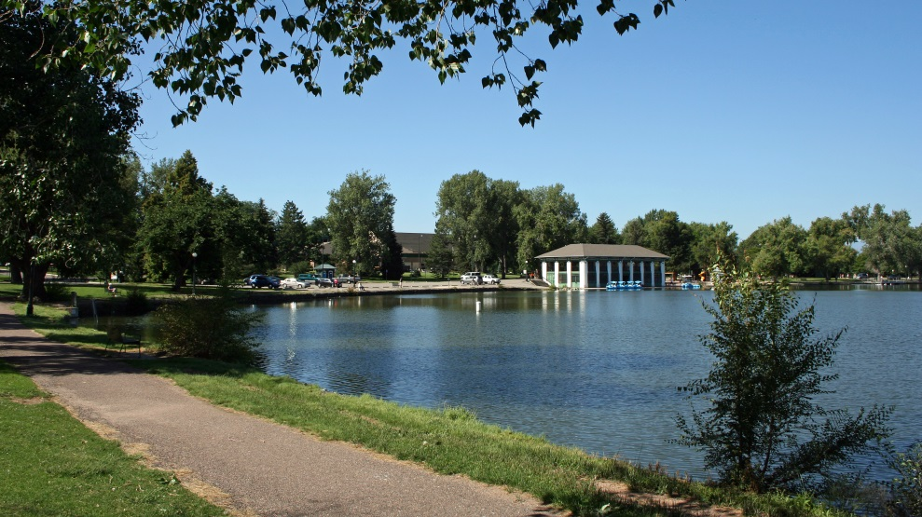
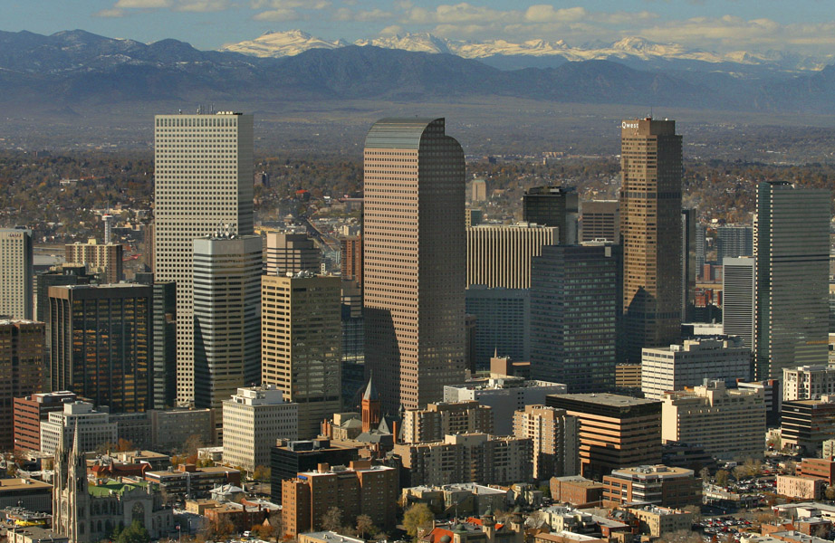
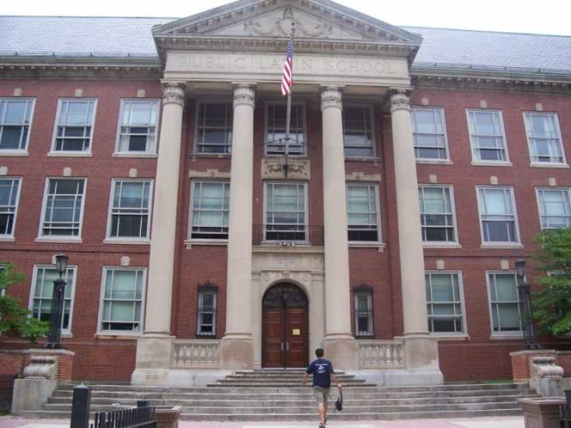
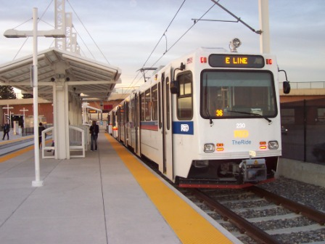
What factors do you consider when choosing housing?

Slide 12
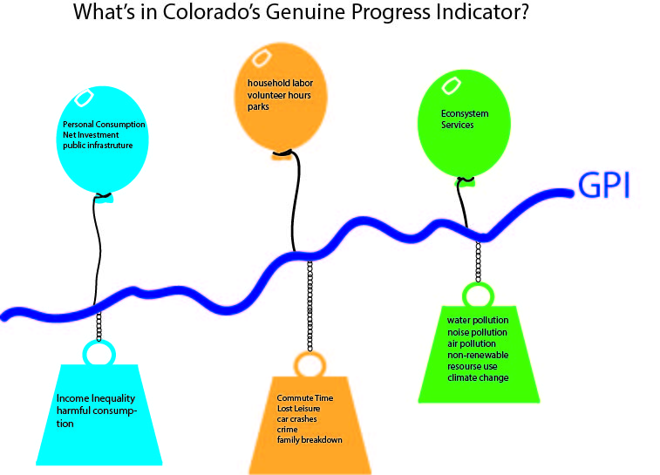
Developing a Measure of Well-Being

Slide 13
The U.S. Census Bureau reported in 2011 the lowest-income 20% of population enjoyed only 3.4% of Colorado income while the top 20% received 49.1%

Slide 14
Income Inequality
A necessary part of a capitalist society because it acts as a signal of the rewards possible for those who work hard and take risks.
Income inequality might not be such a bad thing as long as there is upward mobility in society.
If families in lower-income groups can advance to high-income groups then inequality isn’t necessarily terrible. However, assessing inequality should be considered in the context of upward societal mobility.

Slide 15
Income Inequality
It can harm social cohesion.
It can harm economic welfare by increasing crime, reducing worker productivity, and dampening investment.
In addition, growth in consumption yields different benefits to individuals of different income levels.
It makes a difference who receives the additional income when it grows.
Inequality can also create a loss of potential economic output for society from the unequal opportunities for investment.
This occurs, for instance, when lower-income families cannot set up businesses because of lack of credit or send their children to school. This can ultimately lead to lower future economic potential for the entire state.

Slide 16
Losing Ground About
A special report from the I-News Network, the public service journalism arm of Rocky Mountain PBS
18-month project mining 60 years of US Census and other data to assess the relative well-being of blacks, Latinos and whites in Colorado
Examined family income, poverty, educational attainment, home ownership, health and justice data
Explored beyond the numbers through interviews with community activists, researchers, educators, policymakers and people in the street
http://www.inewsnetwork.org/losingground/

Slide 17
Losing Ground Key-Findings
Despite early civil rights advancements & relative equity, communities of color are losing ground in Colorado.
In 1970, black families in Colorado earned 73 percent of white family incomes and Latinos earned 71.5 percent.
By 2010, black families earned roughly 60 percent of white family incomes and Latinos earned 50 percent.

Slide 18
Losing Ground Key Findings
Wealth disparities growing in Colorado.
In 1970, nearly 60 percent of Latinos owned their own home and roughly 45 percent of blacks owned their home.
By 2010, those numbers dropped to 50 percent and 40 percent, respectively.

Slide 19
Losing Ground Key Findings
Growing inequality manifesting in areas beyond income and wealth.
Unequal access to human capital boosters
education
family well-being
health

Slide 20
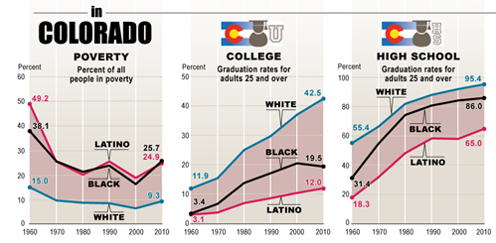

Slide 21
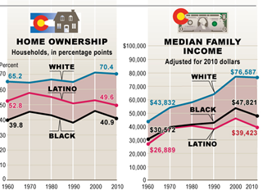

Slide 22
Losing Ground Why didn’t we see it coming?
“I was actually shocked. You would think we as a nation would have overcome a lot of things since then. It’s like, ‘Wow! We’re spinning our wheels going in reverse.’”
- Eric Nelson, vice president of the Aurora NAACP, after reviewing the I-News analysis.
Notes:
These are trends mirrored in many other states. Income inequality and wealth gap growing.

Slide 24
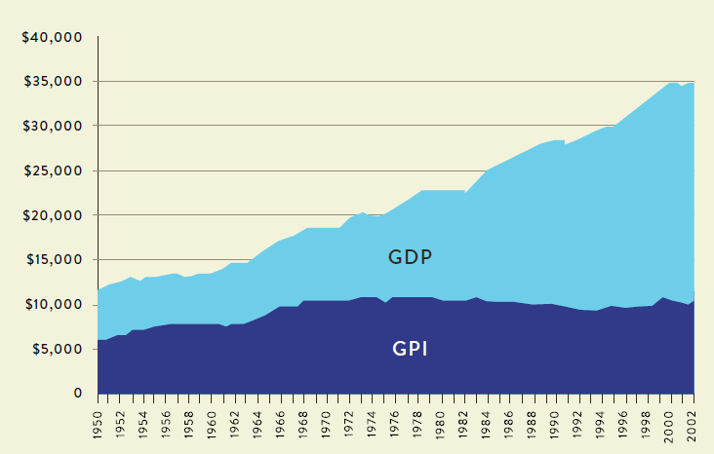
Colorado can be one of the first states to develop a GPI
U.S. GDP vs. GPI

Slide 25
How Can a GPI Keep Us From Losing Ground?
A 2013 report based on MD’s GPI found that if MD returned to late-1960s income equity levels:
$58 B increase in weighted personal consumption
$1.17 B decrease in social costs (crime, family changes, etc.)
$6.10 B increase in consumer spending lower income people
=
$65 Billion in economic benefits, adding a whopping 22 percent to the state’s current annual GSP
Talberth, John, D. Wysham and K. Dolan. “Closing the Inequality Divide: A Strategy for Fostering Genuine Progress in Maryland.” Center for Sustainable Economy/Institute for Policy Studies, March 2013.
Notes:
In other words, why do we care?

Slide 26
How Can a GPI Keep Us From Losing Ground?
A well-constructed GPI with robust equity indicators:
Shines a spotlight on inequality
Helps us better see the way inequality undermines prosperity
Points to paths to close the inequality divide
Hold state policymakers and ourselves accountable

Slide 27
The Way We Measure Well-Being Dictates Policy Discussion
“You can’t improve what you don’t measure”

Slide 28
Prosperity Points to Ponder
What does well-being mean to a Coloradan?
What indicators can we measure to highlight the level of prosperity in Colorado?
Why has GDP lasted so long as a proxy for wellbeing?
Can growth be described as progress if it divides the people?
What does our society value and what should it value?
Contact us: info@coloradofiscal.org

